Slide 1
Curricular practical training
CPT
International Student Services
Josie Hudspeth, Associate Director of Campus Life & Multicultural Inclusion Programs, PDSO
Jose Suarez Diaz, International Student Services Assistant, Portland-Metro

Slide 2
What is Practical Training?
F-1 students studying at an SEVP-approved "college, university, conservatory, or seminary" may be eligible to seek authorization for practical training to engage in temporary employment to gain practical experience directly related to their field of study.
There are two types of practical training:
Curricular practical training (CPT)
Optional practical training (OPT), which consists of 3 kinds:
Pre-completion OPT
Standard post-completion OPT
STEM extension OPT
8 CFR 214.2(f)(10)

Slide 3
Practical Training Comparison
CPT
OPT
Available while enrolled as a student
Must be connected to major field of study
Must have a job offer prior to request
Must be approved by Academic Advisor
PDSO Approval Required
No Application Fee
Can be processed in 1-2 weeks
Full Time (20 hrs+) / Part Time (20 hrs-)
Available while enrolled as a student AND after completion of program
Must be connected to major field of study
Do NOT need a job offer prior to request
SEVP Approval Required
$410 Application Fee
Can take up to 6 months to process
Full Time (20 hrs+) / Part Time (20 hrs-)

Slide 4
CPT
The regulations state that a student may participate in a "curricular practical training program" that is "an integral part of an established curriculum" and "directly related to the student's major area of study."
They define curricular practical training as "alternate work/study, internship, cooperative education, or any other type of required internship or practicum which is offered by sponsoring employers through cooperative agreements with the school."
8 CFR 214.2(f)(10)

Slide 5
Requirements
Student must have been lawfully enrolled on a full-time basis at a SEVIS approved school for one full academic year before being eligible for CPT.
Exception- when immediate CPT is required for graduate level coursework
Available only while student is in F-1 status, before completion of the academic program.
Students may engage in CPT only for the specific employer, location and period approved.
Must be an integral part of an established curriculum, in the student's course of study.
8 CFR 214.2(f)(10)

Slide 6
Requirements Continued
May be granted in increments of no more than one year, or until expected date of employment completion, whichever is shorter.
Available for part-time (20 hours or less) or full-time (over 20 hours) work.
Must have an offer of employment from an employer offering work that qualifies as curricular practical training.
Can be paid or unpaid work.
8 CFR 214.2(f)(10)

Slide 7
Restrictions
Use of full-time CPT for one year or more eliminates eligibility for Optional Practical Training. Use of part-time CPT does not affect eligibility for Optional Practical Training.
Must receive written authorization and updated I-20 with CPT notation from DSO before work begins.
Must continue to maintain a full course of study in F-1 status during the period of employment.
8 CFR 214.2(f)(10)

Slide 8
Things to Consider
Part Time (20 hours/ less) vs. Full Time (20 hours/ more)
What are your career goals?
Does your academic program have mandatory work experience?
Internships
Externships
Fieldwork
Do you intend to pursue off-campus employment during school breaks?
Do you plan to apply for Post-Completion OPT?
Do you plan to pursue a higher level of education?

Slide 9
Oregon Tech’s CPT Approval Process
Receive Job Offer
Submit CPT Request Form Online
Receive Approval from PDSO & Sign New I-20
Finish One Full Year of Study
Work through CPT & Maintain Status

Slide 10
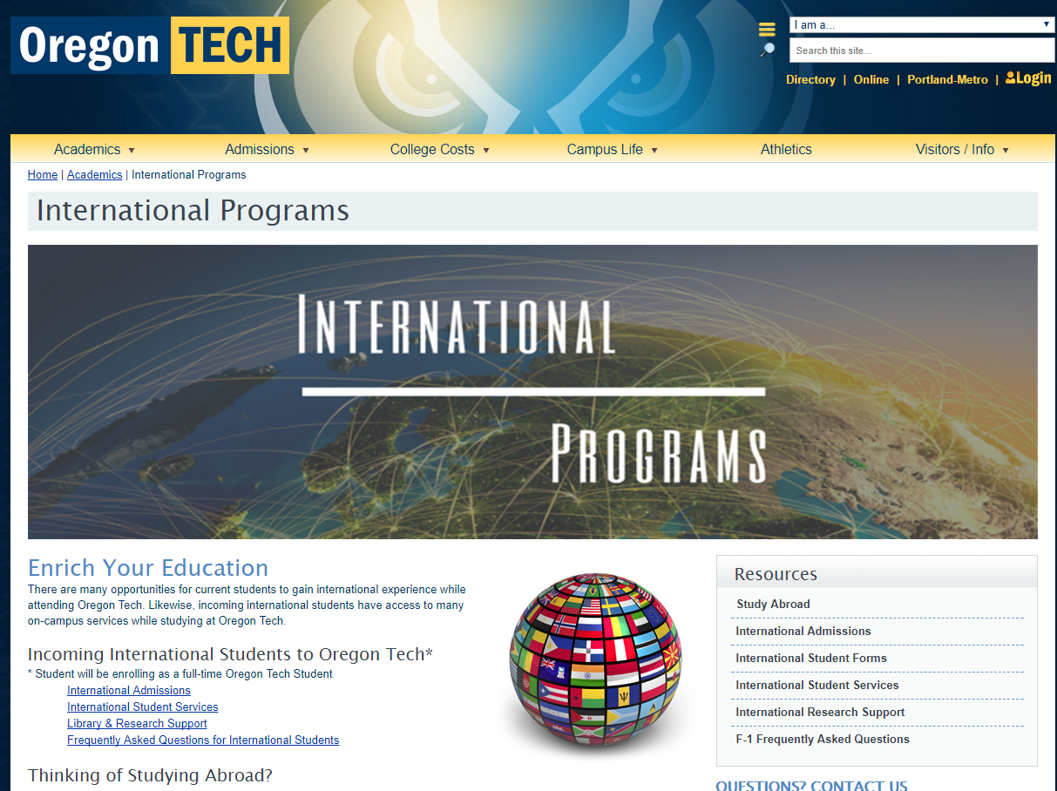
www.oit.edu/
InternationalStudents

Slide 11
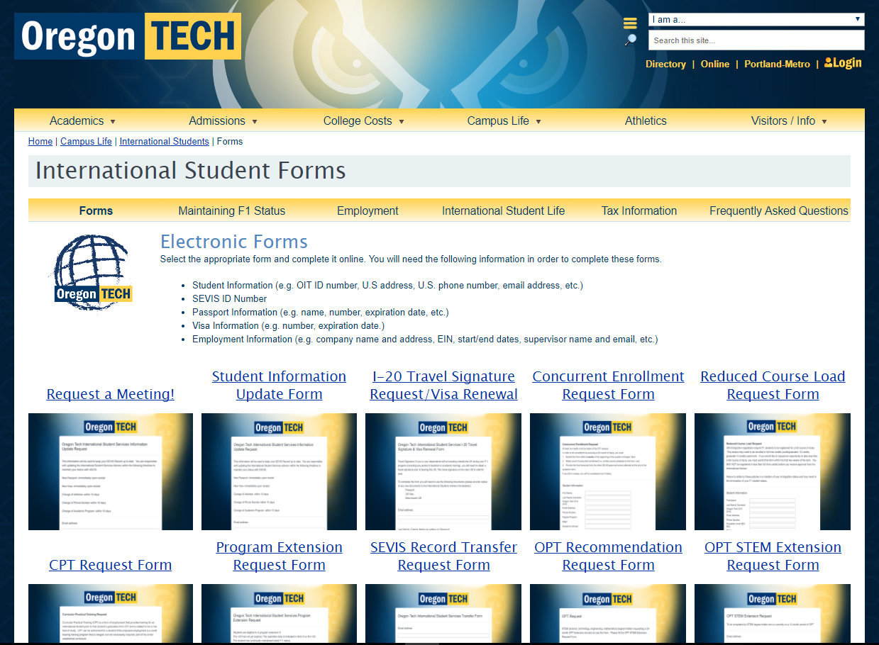
www.oit.edu/
ISSforms

Slide 12
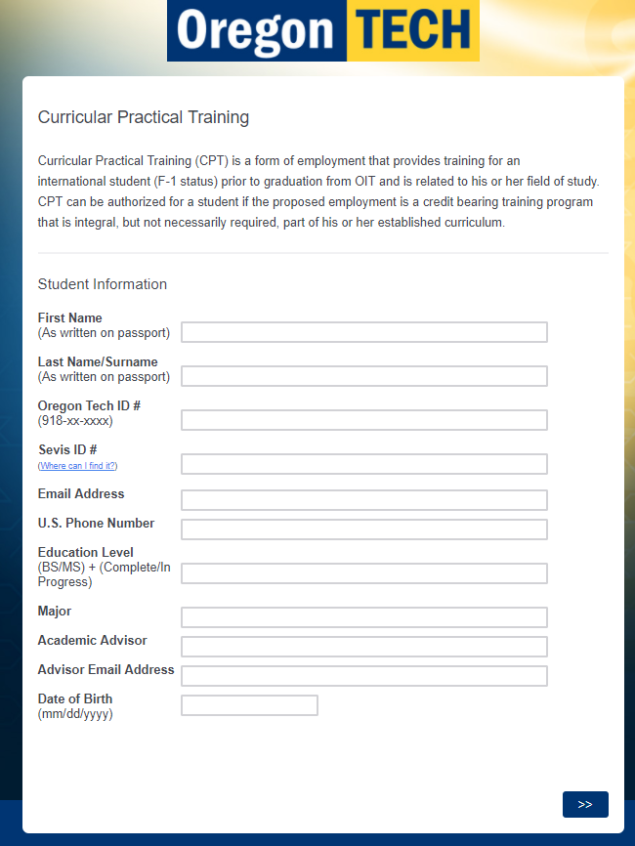
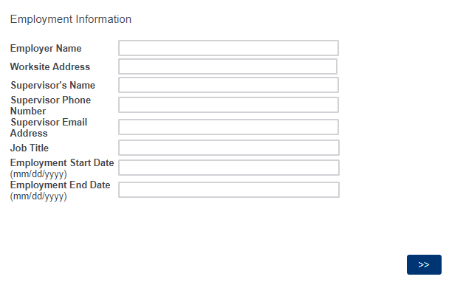
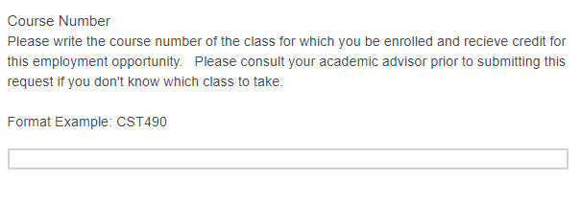
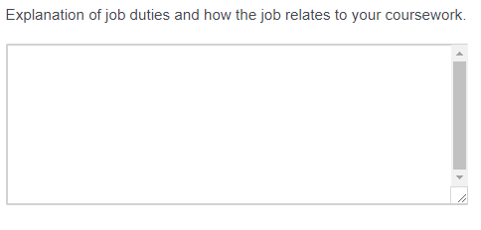
Check the requirements of each ISS Form prior to filling it out.

Slide 13
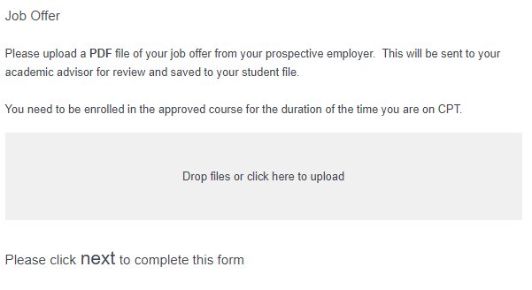
The form is NOT complete until you get to the confirmation screen.

Slide 14
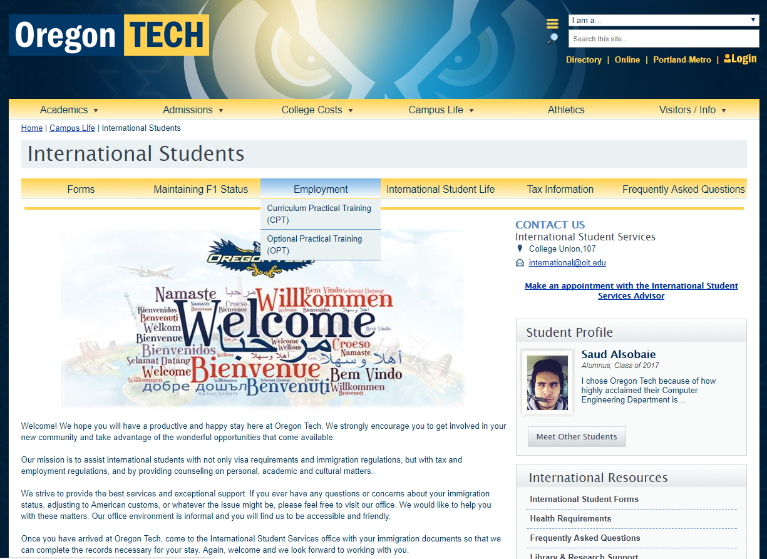
Additional Resources

Slide 15
Questions?
www.oit.edu/InternationalStudents
www.oit.edu/ISSforms
www.oit.edu/ISSemployment
http://www.oit.edu/CPT
Helpful Links

