Slide 1
Optional practical training
OPT
International Student Services
Josie Hudspeth, Associate Director of Campus Life & Multicultural Inclusion Programs, PDSO
Jose Suarez Diaz, International Student Services Assistant, Portland-Metro

Slide 2
What is Practical Training?
F-1 students studying at an SEVP-approved "college, university, conservatory, or seminary" may be eligible to seek authorization for practical training to engage in temporary employment to gain practical experience directly related to their field of study.
There are two types of practical training:
Curricular practical training (CPT)
Optional practical training (OPT), which consists of 3 kinds:
Pre-completion OPT
Standard post-completion OPT
STEM extension OPT
8 CFR 214.2(f)(10)

Slide 3
Practical Training Comparison
CPT
OPT
Available while enrolled as a student
Must be connected to major field of study
Must have a job offer prior to request
Must be approved by Academic Advisor
PDSO Approval Required
No Application Fee
Can be processed in 1-2 weeks
Full Time (20 hrs+) / Part Time (20 hrs-)
Available while enrolled as a student AND after completion of program
Must be connected to major field of study
Do NOT need a job offer prior to request
SEVP Approval Required
$410 Application Fee
Can take up to 6 months to process
Full Time (20 hrs+) / Part Time (20 hrs-)

Slide 4
OPT
The regulations state that a student may participate in a “optional practical training program" that is "directly related to the student's major area of study."
They define optional practical training as "temporary employment for practical training directly related to the student's major area of study."
8 CFR 214.2(f)(10)

Slide 5
OPT: Pre-Completion
The regulations state that a student may participate in a “optional practical training program" that is "directly related to the student's major area of study."
Available before the student's program end date
90 days of unemployment allowed
Full time/ Part time will be deducted from Post-completion opportunity
Full time- only allowed during school breaks/ if you are completing a thesis/ dissertation
Deducted at 100% rate
Part time- allowed while school is in session/ on breaks
Deducted at 50% rate
8 CFR 214.2(f)(10)

Slide 6
OPT: POSt-Completion
The regulations state that a student may participate in a “optional practical training program" that is "directly related to the student's major area of study."
Available after the student's program end date
90 days of unemployment allowed
12 months for each education level
Full time only
8 CFR 214.2(f)(10)

Slide 7
OPT: STEM Extension
The regulations state that a student may participate in a “optional practical training program" that is "directly related to the student's major area of study” in a STEM field and receive up to 24 additional months of work eligibility.
After your 1st year of OPT, STEM majors may apply for a 2-year extension.
24 months for each educational level
Must have an offer of employment
150 days of unemployment (aggregate total) allowed
8 CFR 214.2(f)(10)

Slide 8
Requirements
Student must have been lawfully enrolled on a full-time basis at a SEVIS approved school for one full academic year before being eligible for OPT.
Available only while student is in F-1 status, before and after the completion of the academic program. Work may only begin AFTER student receives the EAD Card (Employment Authorization Document) from USCIS.
Student may work ONLY for the dates listed on the card.
Students must report all employment changes and personal information updates to PDSO within 15 days.
8 CFR 214.2(f)(10)

Slide 9
Plan Ahead!
Each OPT Application costs $410- start saving now!
What are your career goals?
Did you use CPT?
When does your visa stamp expire?
Do you plan to pursue a higher level of education?
Will you need to renew your driver’s license?- Talk to the PDSO.

Slide 10
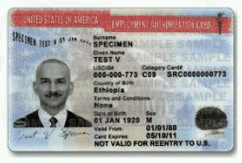
Oregon Tech’s OPT Approval Process
90 Days Before your
I-20 Program End Date
Submit OPT Request Form Online
Complete
I-765 Application
Receive Approval from PDSO & New Signed I-20
$410
Work through OPT & Maintain Status
Receive Job Offer
Receive Approval from USCIS- EAD Card

Slide 11
Oregon Tech’s OPT STEM EXTENSION Approval Process
90 Days Before your
I-20 Program End Date
Receive a Job Offer & Complete I-983 Form
Submit OPT STEM Request Form Online
Complete
I-765 Application
$410
Submit Evaluations Every 6 Months to PDSO
Work through OPT & Maintain Status
Receive Approval from USCIS- EAD Card
Receive Approval from PDSO & New Signed I-20

Slide 12
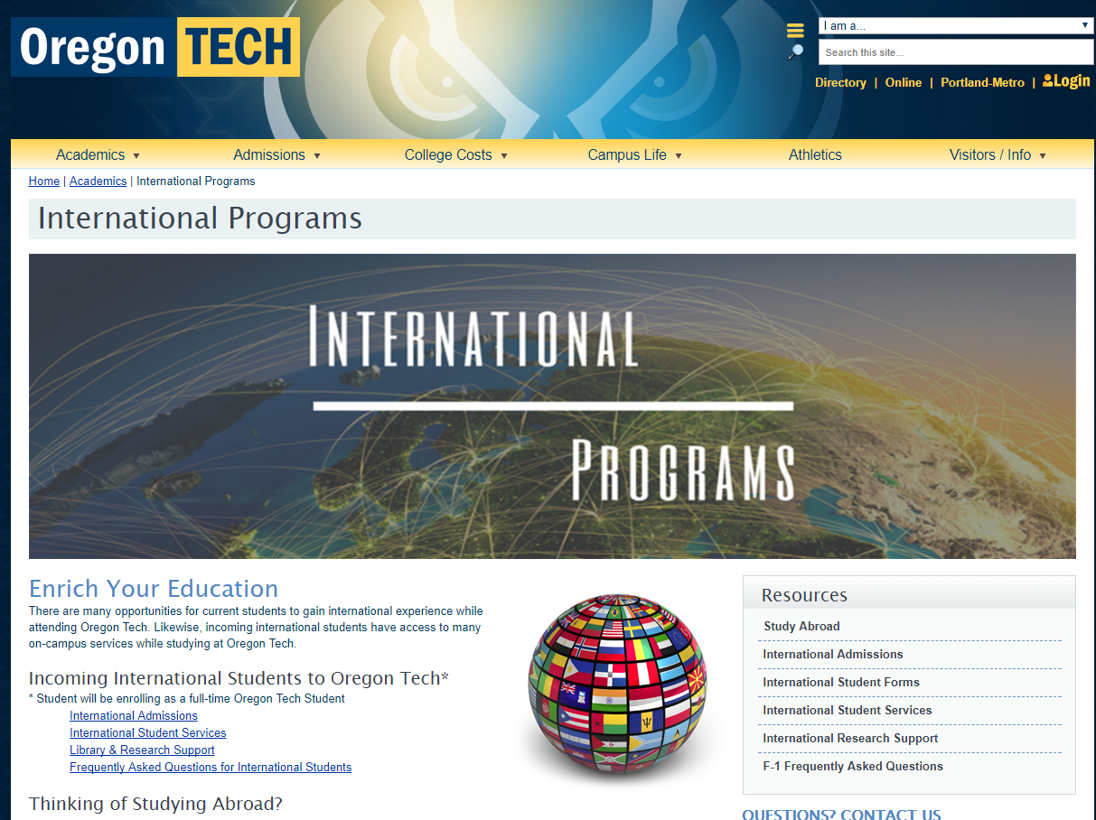
www.oit.edu/
InternationalStudents

Slide 13
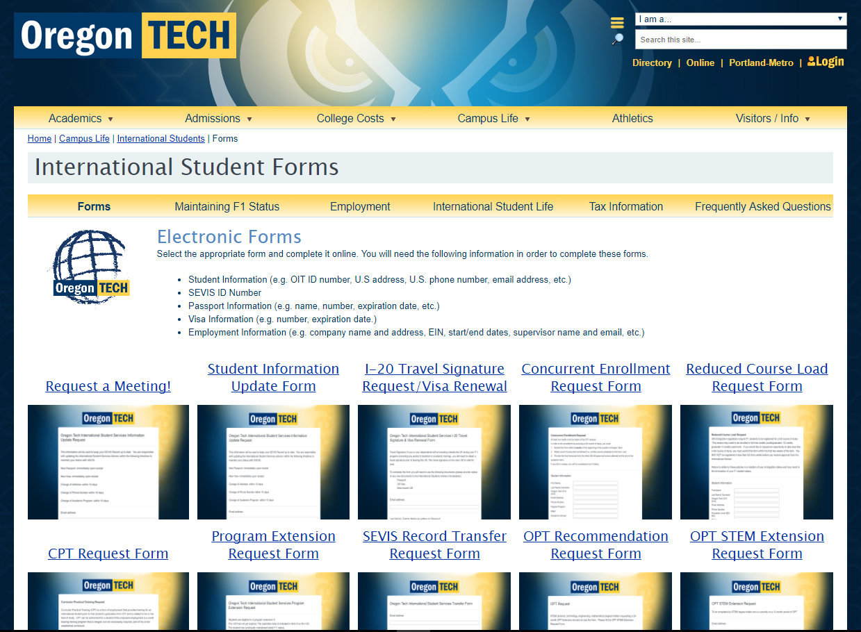
www.oit.edu/
ISSforms

Slide 14
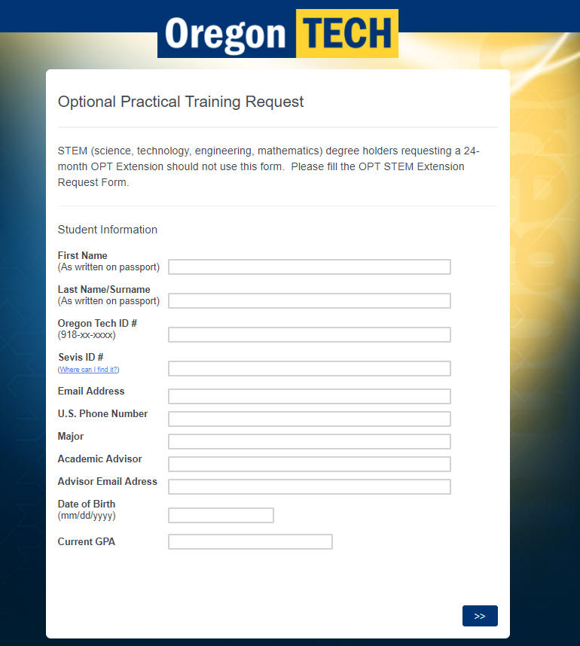
Check the requirements of each ISS Form prior to filling it out.

Slide 15
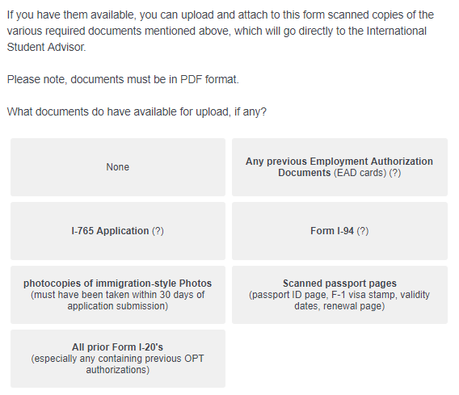
The form is NOT complete until you get to the confirmation screen.

Slide 16
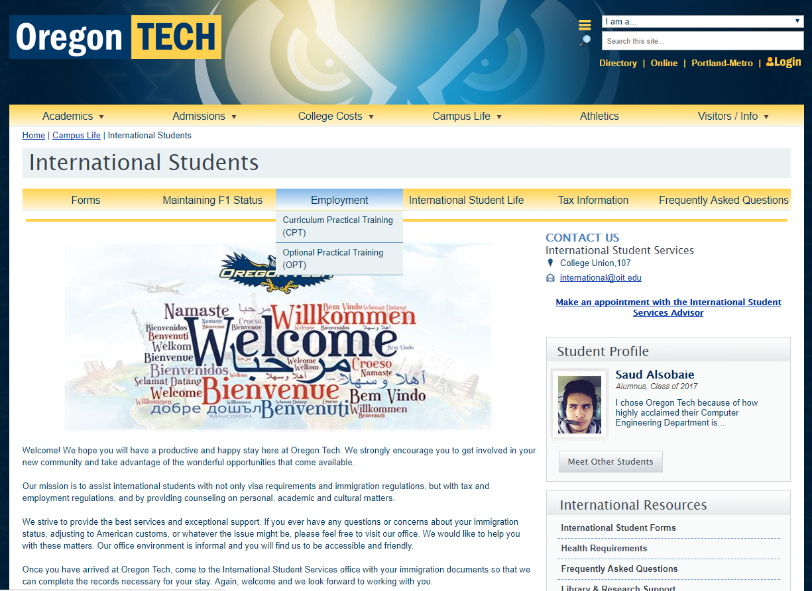
Additional Resources

Slide 17
Questions?
www.oit.edu/InternationalStudents
www.oit.edu/ISSforms
www.oit.edu/ISSemployment
http://www.oit.edu/OPT
Helpful Links

